Slide 1
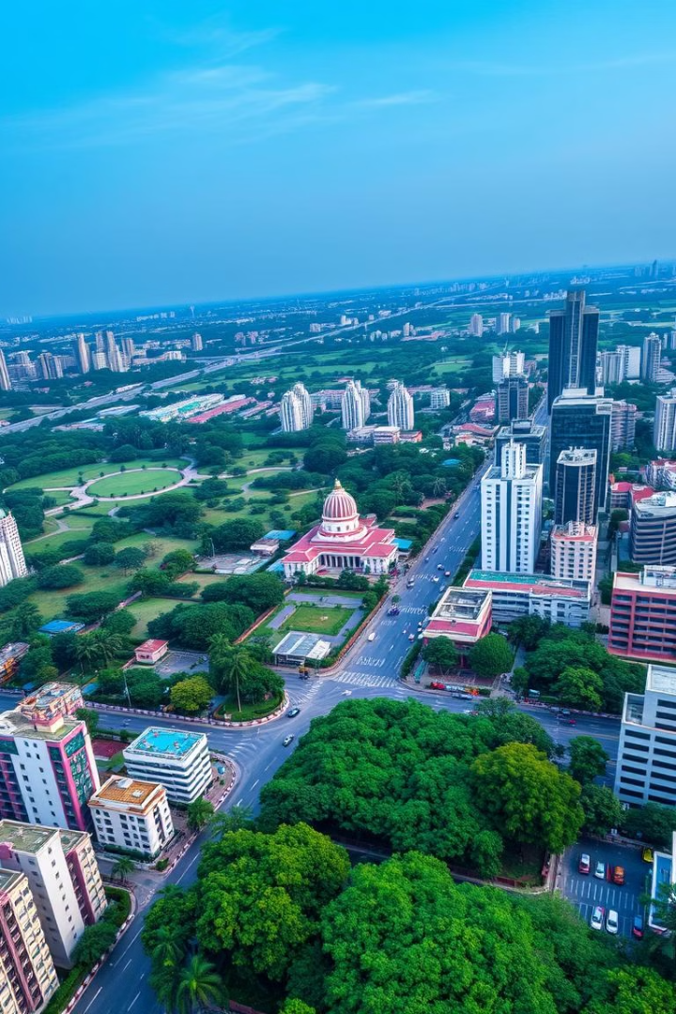
Discover Air Quality in India
Welcome to India! This app helps you understand the air you breathe. It uses real-time weather data to predict air quality for various locations across India.
by Praveen Kumar
PK

Slide 2

Predicting Air Quality
1
Data-Driven Predictions
2
Key Air Quality Indices
3
Real-time Information
The app utilizes a sophisticated AI model trained on diverse weather parameters, including temperature, humidity, pressure, and wind speed.
The model predicts crucial indices like CO and NO2 concentration, providing insights into the quality of the air you're breathing.
Stay informed with up-to-the-minute predictions based on constantly evolving weather conditions, ensuring you have the latest air quality data.

Slide 3

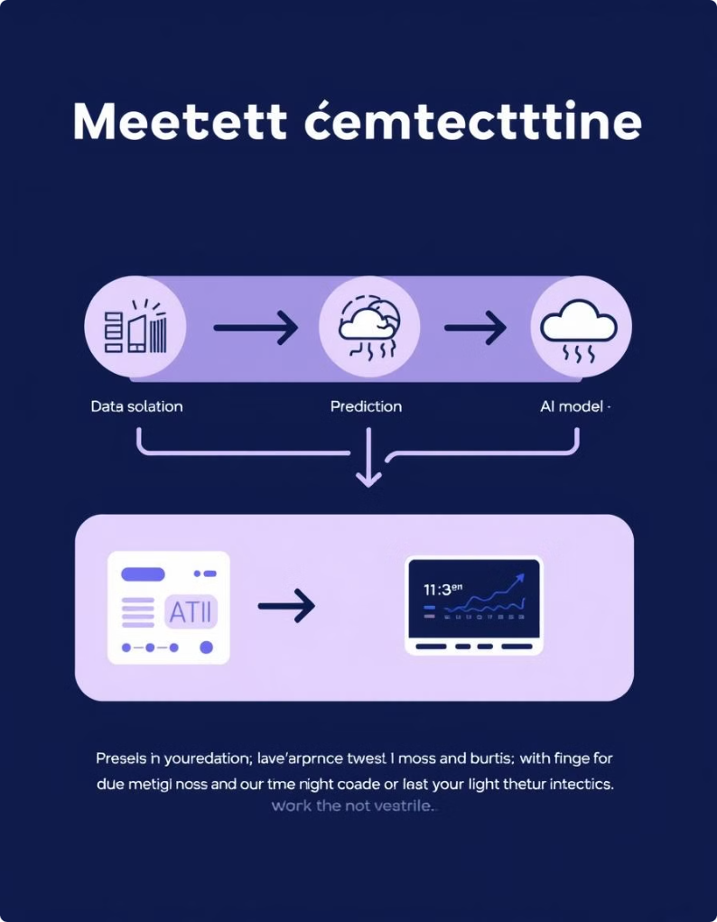
How It Works
1
Enter Location
Start by entering the city you're interested in exploring. The app will automatically identify its location.
2
Retrieve Weather Data
The app retrieves real-time weather data for the chosen city, pulling information from reliable weather sources.
3
Predict Air Quality
The trained AI model processes the weather data and predicts the key air quality indices for that specific location.
4
Display Results
The predicted air quality indices are presented to the user in a clear and understandable format, empowering them to make informed decisions.

Slide 4

CITY NAME: A Case Study
Temperature
28.18 °C
Humidity
76%
Pressure
1010 hPa
Wind Speed
3.65 m/s
CO Concentration
-77.64 µg/m³
NO2 Concentration
20.01 µg/m³

Slide 5
Understanding Air Quality Indices
CO Concentration
NO2 Concentration
Carbon monoxide (CO) is a colorless, odorless gas that can be dangerous to your health.
Nitrogen dioxide (NO2) is a reddish-brown gas that contributes to smog and acid rain, harming respiratory systems.

Slide 6
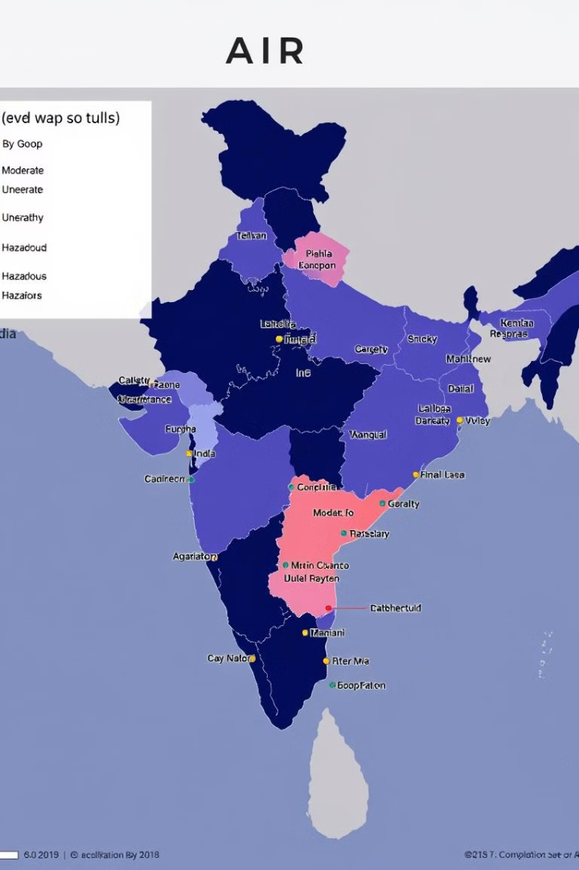



Explore Air Quality Across World
Explore Cities
Discover air quality predictions for various cities across India, from bustling metropolises to serene hill stations.
Compare Locations
Compare air quality across different regions to understand the impact of various factors, such as industrial activity and weather patterns.
Make Informed Decisions
Use this knowledge to plan your travels or adjust your daily activities, prioritizing your health and well-being.

Slide 7




Protecting Your Health
Wear a Mask
Wearing a mask, especially in areas with high pollution, can help protect your respiratory system.
Choose Green Spaces
Spending time in parks and green areas with clean air can help improve your well-being.
Stay Informed
Regularly check air quality predictions and adjust your activities accordingly to minimize exposure to pollutants.

Slide 8

Embrace Sustainable Practices
Reduce Vehicle Emissions
Choose public transport, cycling, or walking whenever possible to reduce your carbon footprint.
Support Sustainable Industries
Choose products and services from companies committed to environmental responsibility.
Plant Trees
Trees absorb pollutants and improve air quality. Plant a tree or support tree-planting initiatives.

Slide 9
CONCLUSION
By leveraging advanced technology and engaging with communities, we can effectively address the growing concern of air pollution. This platform empowers individuals with real-time insights, promoting informed decisions and collective action towards a cleaner and healthier future.
This innovative approach fosters a sense of responsibility and empowers individuals to become active participants in the journey toward cleaner air. By harnessing the power of technology and community engagement, we can work together to create a more sustainable and breathable environment for generations to come.

